Slide 1



FINAL PROJECT
KARANKUMAR PATEL (200575303)
Data system architecture
Bdat1002

Slide 2
SUMMARY
This project has been made with the help of big data tools like Hadoop and Spark which I have learned throughout the semester.
the data set selected for this project is the brewery operations and market analysis data set.
It has been taken from the Kaggle website which is given below.
Website for dataset: https://www.kaggle.com/datasets/ankurnapa/brewery-operations-and-market-analysis-dataset

Slide 3
summary
this data set had so many columns which were not required for analysis.
So, some columns were deleted from them which will be discussed further.
The steps that were followed in the project are mentioned further.
I have faced some challenges and how I solved them is also mentioned.

Slide 4

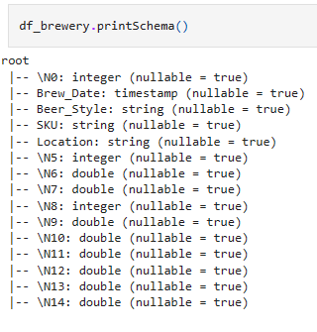
challenge
I have faced one problem in the spark session.
While creating the table in Spark I got the heading as null.
Which is shown in the picture.
And despite checking all the steps it was not getting solved.

Slide 5
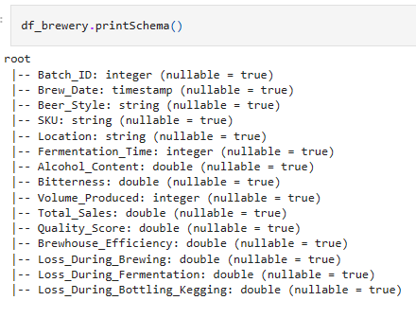
Solution
In jupyter notebook I have renamed the header using the below command.
Defined new named with new_header=[ ]
Applied it with df_brewery= df_brewery.todf(*new_header)
Result is shown in the picture.

Slide 6
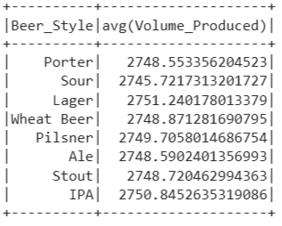
Finding 1
In this I wanted to find the average volume production of various beer styles.
Using the df.average command I calculated the average production and it is shown in the table format first.
It is shown in the picture.
Then it is also shown in a pie chart to have visual graphics and have a better understanding of this particular finding

Slide 7
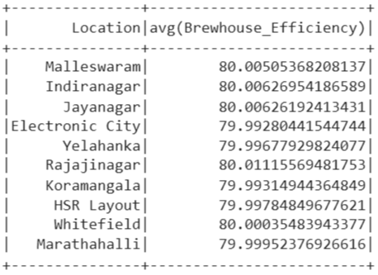
Finding 2
In this finding I wanted to find the brewhouse efficiency for different locations.
So, first it was grouped by location using df_brewery.groupby( ) command.
Then the efficiency for every location found.
It shown in the picture.

Slide 8
experience
I have a great experience throughout the semester in this course.
I have learned how to use big data tools like Hadoop and speak effectively.
And how to use them to analyze the dataset.
Especially in this final project using these tools to analyze a dataset of the size of 1 GB.

Slide 9
conclusion
In conclusion, it can be said that always having good support from the professor helped me a lot.
This learning will be very beneficial for me in the future.
And I’m so grateful for that.

Slide 10

Thank you

